Slide 1
Train custom object detector with TFLite Model Maker
TensorFlow Lite model with your own custom dataset reduces the amount of training data required and will shorten the training time. And help us to create the custom model using own datasets.
Key Features:
  Optimized for on-device machine learning, by addressing 5 key constraints: latency (there's no round-trip to a server), privacy (no personal data leaves the device), connectivity (internet connectivity is not required), size (reduced model and binary size) and power consumption (efficient inference and a lack of network connections).
  Diverse language support, which includes Java, Swift, Objective-C, C++, and Python.
  High performance, with hardware acceleration and model optimization.
  End-to-end examples, for common machine learning tasks such as image classification, object detection, pose estimation, question answering, text classification, etc. on multiple platforms.

Slide 2
Dataset preparation:
The dataset is the labelling and grouping the sample images and finally load into the code.
We can prepare the different methods. one is csv format and another one is the pascal_voc format which is a type of a xml file.
  Training images: These images are used to train the object detection model to recognize salad ingredients.
  Validation images: These are images that the model didn't see during the training process. You'll use them to decide when you should stop the training, to avoid overfitting.
  Test images: These images are used to evaluate the final model performance.
CSV format:
  Model Maker will take input data in the CSV format. Use the object_detector.DataLoader.from_csv(‘csv_path’) method to load the dataset and split them into the training, validation and test images.
  Eg:
  test_data = object_detector.DataLoader.from_csv('gs://cloud-ml-data/img/openimage/csv/salads_ml_use.csv’)
  train_data = object_detector.DataLoader.from_csv('gs://cloud-ml-data/img/openimage/csv/salads_ml_use.csv’)
  validation_data = object_detector.DataLoader.from_csv('gs://cloud-ml-data/img/openimage/csv/salads_ml_use.csv')

Slide 3
Pascal_voc format:
  This is the method to load data with PASCAL VOC format. makesense.ai and LabelImg are the tools that can annotate the image and save annotations as XML files in PASCAL VOC data format.
object_detector.DataLoader.from_pascal_voc
train-data = object_detector.DataLoader.from_pascal_voc(image_dir, annotations_dir, label_map={1: "person", 2: "notperson"})
Eg:
train_data = object_detector.DataLoader.from_pascal_voc('/content/train', '/content/train', ['drone’])
validation_data = object_detector.DataLoader.from_pascal_voc('/content/test', '/content/test', ['drone’])
In here the first parameter inside the pascal_voc function is the path of the train labelled images and the second parameter is also the same thing we can just feed the same path in it. The third thing is the label or labelmap.

Slide 4
Train object detect model
Contents:
Package installations.
Prepare the dataset.
Train the object detection model.
  Choose an object detection model architecture.
  Load the dataset.
  Train the tensorflow model with the training data.
  Export the model.
Optional(Model evaluation).

Slide 5
Package installations:
Install these packages:
  1. --use-deprecated=legacy-resolver tflite-model-maker
  Pycocotools
  !pip install -q kaggle
  !pip install -q kaggle-cli
Import these packages:
  import numpy as np
  import os
  from tflite_model_maker.config import ExportFormat
  from tflite_model_maker import model_spec
  from tflite_model_maker import object_detector
  import tensorflow as tf
  assert tf.__version__.startswith('2')
  tf.get_logger().setLevel('ERROR')
  from absl import logging
  logging.set_verbosity(logging.ERROR)

Slide 6
Dataset preparation:
  For the labelling the sample images in the local machine we can use the labelimg tool. Which is used to label the image that we generate the xml type of file during the labelling of the image.
  Installation of the labelling tool:
        pip install labelImg
Labelling images:
  1.Open the labelimg tool in the command prompt and by clicking the open dir option in the tool to open the folder of the collected images.
  2.Clicking the rectangular box option in the tool using that crop the object in the images and label it after the labelling save each one then only the xml file will be get saved in the same folder.
  3.The xml will be saved in the same folder where the images kept.
  4. Finally we got the images and the xml files in it.

Slide 7
Object detection model training:
  In here the model is get generated there are some steps to prepare a model those steps are as follows.
  Select the object detection model architecture:
    EfficientDet-Lite[0-4] are a family of mobile/IoT-friendly object detection models derived from the EfficientDet architecture.
  Here is the performance of each EfficientDet-Lite models compared to each others.
      Model architecture Size(MB)* Latency(ms)** Average Precision***
      EfficientDet-Lite0 4.4 37 25.69%
      EfficientDet-Lite1 5.8 49 30.55%
      EfficientDet-Lite2 7.2 69 33.97%
      EfficientDet-Lite3 11.4 116 37.70%
      EfficientDet-Lite4 19.9 260 41.96%
  After that get the model_spec from this architecture:
    This is the function code to select the model architecture for our custom tflite model.
    Eg:
    spec = model_spec.get('efficientdet_lite0')

Slide 8
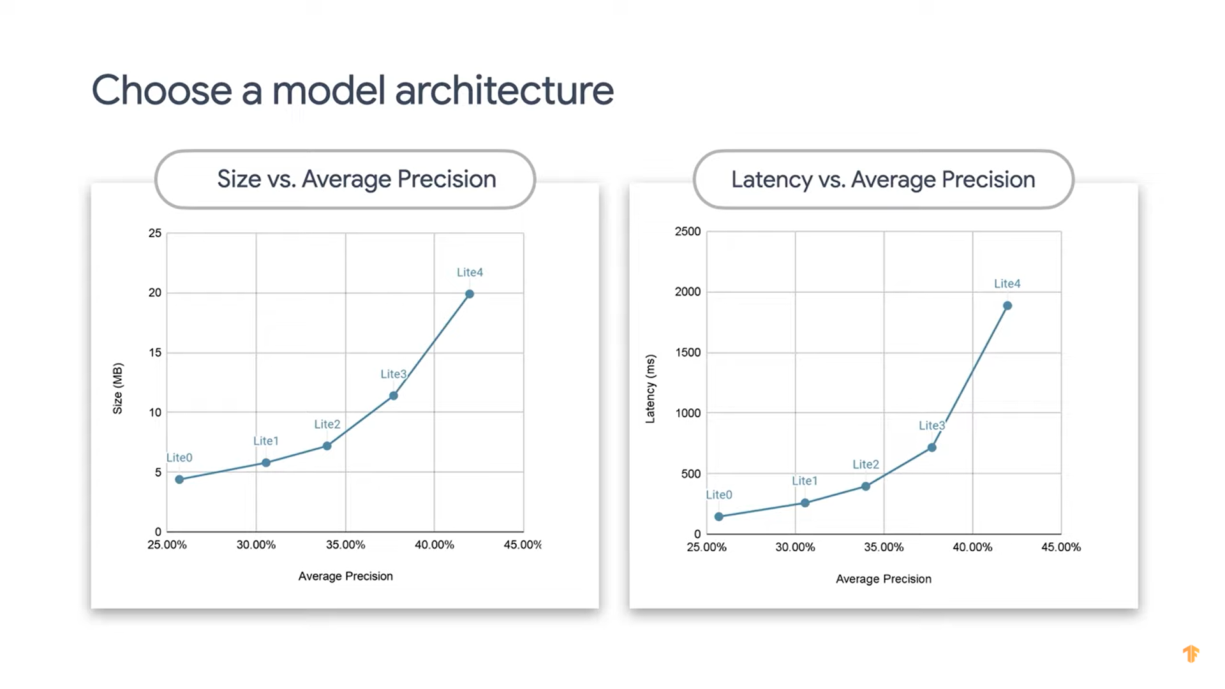

Slide 9
Load the dataset:
  This is the method to load data with PASCAL VOC format. makesense.ai and LabelImg are the tools that can annotate the image and save annotations as XML files in PASCAL VOC data format.
  Dataset load function code format:
  train-data = object_detector.DataLoader.from_pascal_voc(image_dir, annotations_dir, label_map={1: "person", 2: "notperson"})
  Eg:
train_data = object_detector.DataLoader.from_pascal_voc('/content/train', '/content/train', ['drone’])
validation_data = object_detector.DataLoader.from_pascal_voc('/content/test', '/content/test', ['drone’])
Model training:
  Training a model simply means learning (determining) good values for all the weights and the bias from labeled examples. In supervised learning, a machine learning algorithm builds a model by examining many examples and attempting to find a model that minimizes loss.
  Model training code format:
    model = object_detector.create(train_data, model_spec=spec, epochs=50, batch_size=8, train_whole_model=True, validation_data=validation_data)

Slide 10
Model training function method example:
  This is the code to train the tflite model. After that we shall export the tflite model by the following procedures.
    model = object_detector.create(train_data, model_spec=spec, epochs=40, batch_size=8, train_whole_model=True, validation_data=validation_data)
Model export :
  After the model training we can export it by using the following comments.
  Model export method format:
    model.export(export_dir=‘model_export_path’)
  After that we will get the model.tflite in the path that we provided.
Model evaluate:
  You can also evaluate the tflite model with the evaluate_tflite method. To know the accuracy of the model. It will show the model accuracy model.
    model.evaluate_tflite('model.tflite', test_data)

Slide 11
Thankyou

